Slide 1

Properties of Major Bond Types
Essential Question: What are the characteristics of each type of bond?
Objective: We will compare and contrast ionic, covalent, and metallic bonds.

Slide 2
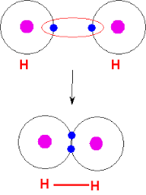
What is a COVALENT bond?
A bond between a nonmetal and nonmetal
When electrons are shared between atoms

Slide 3
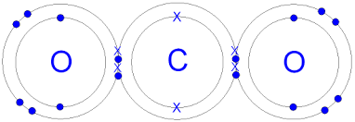
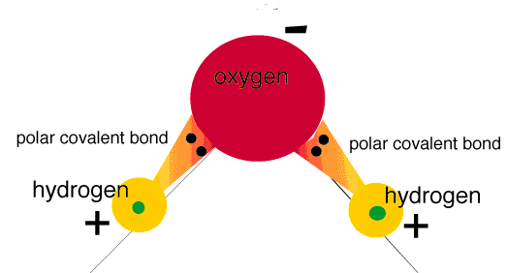
What is a COVALENT bond?
3. Examples:
Nonpolar: electrons shared equally
ex) CO2
Polar: unequally shared electrons
ex) H2O

Slide 4
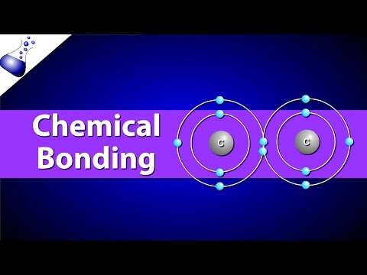
What are the properties of COVALENT bonds?
4. Low melting points
5. Insoluble in water (does not dissolve)
6. Usually does not conduct electricity

Slide 5
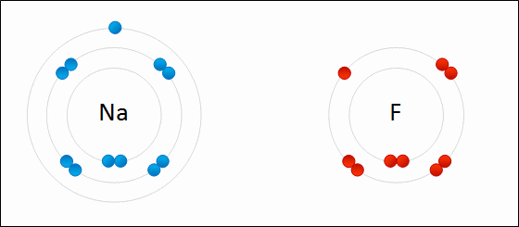
What are the properties of IONIC bonds?
Between a metal and nonmetal
Electrons are transferred from one element to another

Slide 6
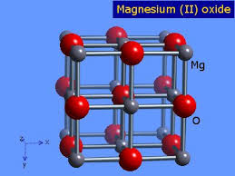
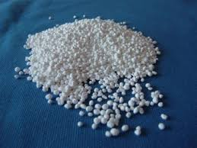

What are the properties of IONIC bonds?
3. Examples: CaCl2, MgO, FeO

Slide 7
What are the properties of IONIC bonds?
4. High melting points
5. Soluble in water
6. Conducts electricity
Link

Slide 8
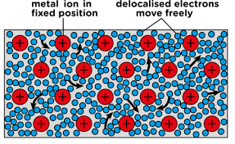
What are the properties of METALLIC bonds?
Between a metal and metal
Electrons are shared between all connected elements (not just between two atoms)
  Called a “sea of electrons”

Slide 9
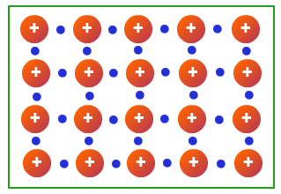
What are the properties of METALLIC bonds?
3. Examples: Copper wire: Cu-Cu, Bronze: Cu-Sn

Slide 10
What are the properties of METALLIC bonds?
4. High melting points
5. Insoluble in water
6. Conducts electricity

Slide 11
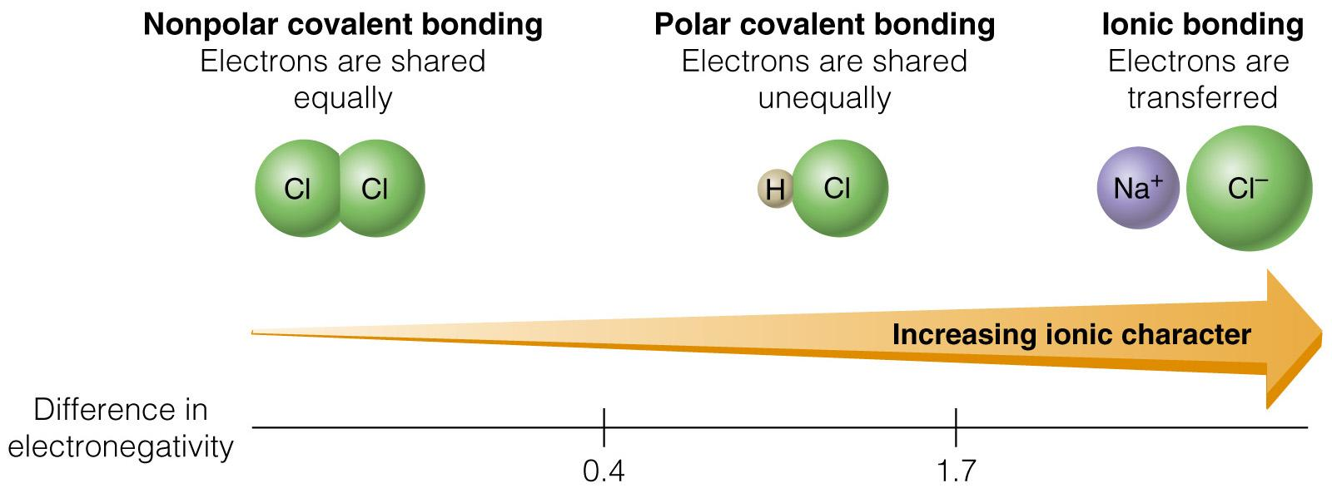
How do you determine the type of bond?
Identify whether the elements are metal or nonmetal
If between two nonmetals, check the electronegativity difference to see if it is polar or nonpolar covalent

Slide 12

4. How do we find data on specific elements?
Practice:
Compound | Type of Elements (Metal or Nonmetal) Element #1 Element #2 | Electronegativity Difference (only if between two nonmetals) | Type of Bond: (Nonpolar covalent, Polar covalent, Ionic, Metallic)
NaCl | Metal + Nonmetal | X | Ionic Bond
MgCl₂ | +
Br₂ | +
N₂ | +
HCl | +
H₂O | +
CO₂ | +
NH₃ | +
CH₄ | +
NH₄⁺ | +
H₃O⁺ | +
H₂C₂HOH | +

Slide 13
Closure: Create a diagram of the bonds and their properties

